Slide 1
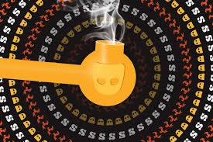
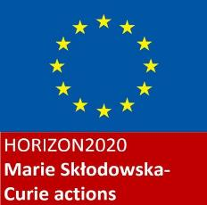
A weak theory of bareback and chemsex through the self-narratives of HIV-positive gay men in three South European cities
Cesare Di Feliciantonio
(University of Leicester)
difeliciantoniocesare@gmail.com
RN23 Midterm Conference 2019 “Sociological explorations of sexuality in Europe: bodies, practices, and resistance in troubled times” (Cracow, 14-15/02)

Slide 2
Research background
2014-2016: 24 biographical interviews with HIV-positive gay men in Barcelona (Italian and French) and Rome (domestic)
Ongoing research on HIV-positive gay migration in England (Leicester; Manchester) and Italy (Bologna; Milan)
Today’s focus: 32 interviews in Barcelona, Rome and Milan
Main aim: unpack the complex negotiations between sexual practices, place, spatial imagery, mobility/tourism, bodies, the performance of masculinities and drugs consumption

Slide 3
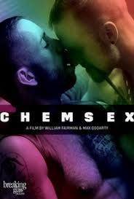
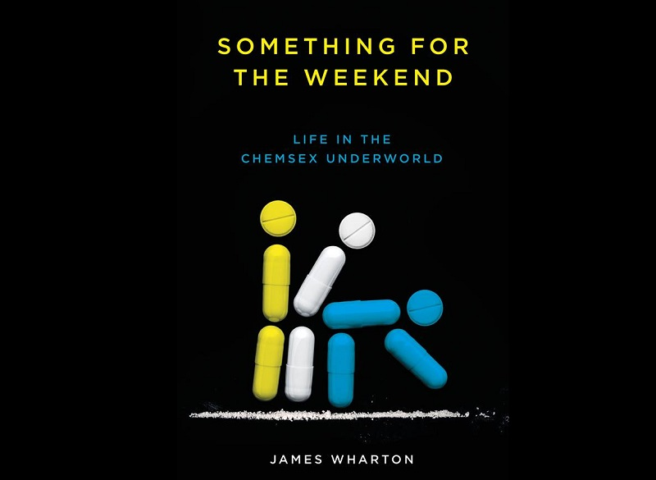
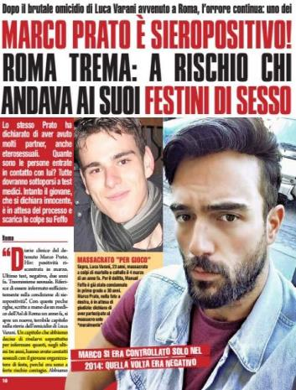
Transnational panic around chemsex (and HIV)

Slide 4
Main argument
Place occupies a central role in the research participants self-narratives around chemsex and bareback. It is constructed relationally, through movement and encounter with other places. In these narratives, Italy is represented as sexually backward.
3 main (interconnected) dimensions of place:
Physical (e.g. home, the sauna, the club, the ‘gayborhood’)
Imaginary (e.g. specific cities abroad exercise a strong ‘sexual power’)
Digital (e.g. hook-up apps)

Slide 5
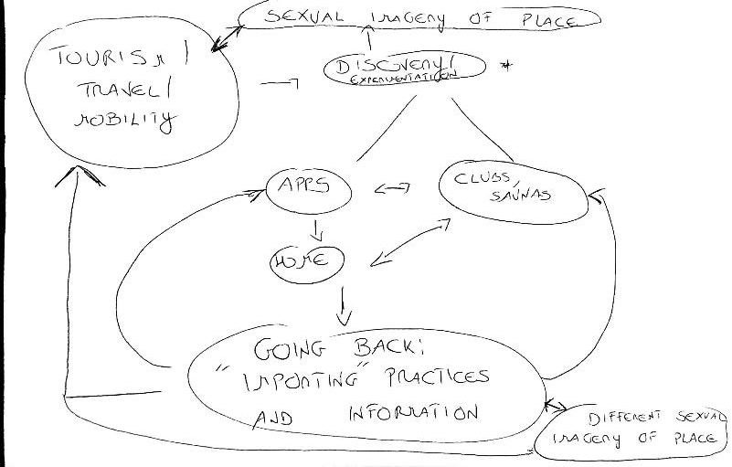
Mental map created to analyze the narratives around mobility, place and sexual experimentation (discussed with 5 participants)

Slide 6
A ‘weak’ theory of bareback sex and chemsex?
Del Casino Jr (2007): need of a ‘weak’, ‘flaccid’, ‘soft’ theory to study the relationship between sexuopharmaceuticals, sex and healthy/ill sexual identities
‘Weak’ theory (e.g. Tomkins, Gibson-Graham, Sedgwick): things seen as open, entangled, connected and in flux.
S. Wright (2015,p. 392): “rather than closing down, categorizing, judging, modelling and getting things ‘right’, weak theory is open to possibilities (...) It ponders connections and trajectories, and wonders what ways of knowing, heeding and caring are possible”
Focus on practices, ordinary, more-than-human and heterogeneity

Slide 7
A ‘weak’ theory of bareback sex and chemsex? (2)
Del Casino Jr.: health geographers need to adopt a relational and situated perspective on sexual practices and identities + need to de-pathologize sexual practices and specific bodily functions
(2007, p. 910): “we need to more explicitly investigate the geographic nature of the relations between drug use and sexual practice—the networked relations of drugs and sex, the reorganization of space in relation to the use of drugs and practices of sex, and the performances of place through the use of drugs.”

Slide 8
Relational geographies of sex (1): mobility and tourism
Specific cities (Amsterdam, Barcelona, Berlin, Brussels) play a central role for sexual experimentation
RC: (...) so I discovered bareback [English word used] when I was visiting a friend in Amsterdam (...)
Q: What do you mean that you discovered bareback? Was your first unprotected intercourse?
RC: Of course not! Most of the time I did bareback [smiles]
Q: So why do you say that you discovered it in Amsterdam?
RC: I mean, I was at this party and literally everybody was barebacking! I asked my friend and he explained me that it was very common in Amsterdam. (…) In Italy it was nothing like that.
Q: So you think in Italy bareback was not very widespread...
RC: It’s more complicated than that, in Italy too bareback is very common but you don’t say it, people here are hypocrites, while abroad you can talk about it, you can write it in your Grindr profile, sex is less stigmatized.

Slide 9
Relational geographies of sex (2): Italy as ‘backward’ (Rome, 2016)
GN: (...) Sometimes I feel like people here don’t know anything, it’s like they don’t watch porn, I don’t really understand, (....) apparently nobody does bareback [English word used], nobody uses drugs, everybody is HIV-negative. (...) Many times people stopped chatting with me because I said I was HIV-positive, (...) at the beginnings I did not use to disclose my status here and when I met guys they were cool with doing bareback or whatever, I hate it (...), this country is so backward [arretrato], any other place I travel to people are cool with naming things.
Q: So you were saying that now you usually disclose your status...
GN: Yes, I learnt a lot, I informed myself, I’m healthy, I’m undetectable, why should I hide myself? I’m not a danger to anyone, so I want people to know that, I’m very open about my status, (...), I think it is very important to share information and knowledge, when people are smart enough to have a conversation I send them links and articles about undetectability, PrEP, barebacking.

Slide 10
Relational geographies of sex (3): everybody does chemsex but is HIV-negative (Milan, 2018)
“Today I counted 76 profiles referencing to bareback and/or chemsex on Grindr (3 hours spent in total; radius of 3km from my location), none of them stated ‘undetectable’ for HIV-status, 24 ‘negative on PreP’, 9 ‘negative’, 43 no status shown” (research diary, Milan, July 2018)
SEDI: (...) this is Milan, chemsex everywhere but everybody is negative.
Q: How do you feel about that? Do you usually disclose your status?
SEDI: Naaa, why should I? I don’t go to chemsex parties to chat, I want to smoke and have sex.
Q: What do you usually smoke?
SEDI: Basata [smoked cocaine] like everyone else, people here usually use that or G.
Q: So in your experience people don’t smoke T at sex parties?
SEDI: I know why you are asking that, abroad T is very common, here not much. (...) I remember using T in Amsterdam, it was crazy (...) Maybe at some point it will become popular here too, everything comes late in Italy, but I’m not sure, too expensive for the Italian standards I think.

Slide 11
Relational geographies of sex(4): apps and home
Primary sites for experimentation and information
The private home chill-outs (a very common word to refer to home chemsex parties, usually open to strangers) as friendly places to meet new people
JD: “I like having lots of people around my place, I have made so many friends through Grindr. We go out, spend lot of time together, holidays, (...), you know I had a very hard time after the HIV diagnosis, now I definitely feel less alone, (...), I’m pretty lucky since I own my flat and have a decent salary so I can afford to invite people for partying here, there is always someone new, it’s fun, (...), my closest friends are allowed to stay even for days, when I’m at work, I don’t mind, most of them live with their parents or share flats so I help them”

Slide 12
Relational geographies of sex (5): apps and home
Tight connection between the digital space of the hook-up app and the private/public character of home (usually open and accessible to anyone connected)
Alienation/isolation vs sense of belonging
Social class (not everyone can host a house party) + sharing (wealthy participants usually share drugs they have but this can be a source of tension)
Challenge to hegemonic values of beauty and masculinity (e.g. NN: “you are living the moment, you are high, lost in pleasure, there is no age or beauty standard, (...), at some point you can really fuck whoever you want”

Slide 13
Challenging hegemonic masculinities
Chemsex parties open the possibility to challenge ideas and stereotypes around masculinities and the ‘hard on’
Q: Would you say that sex is the most important thing in a chill-out?
SX: I’m not sure about that, drug is the main thing, you want to be high, you want to have a good time, you chat, you laugh, you fuck, you get lost in your mind, you sleep on a couch, (...), sometimes nobody gets hard!
Q: What happens then? Do you use Viagra?
SX: I used to but I realized it didn’t really work for me, I never get hard! (...) If there is sex, I bottom [laughs]
Q: Are you ok with it?
SX: Sure, most of the people do not get really hard! (...) The fun part is being together, having a good time, I would say it is more about the realization of a fantasy, (...), if there is a top guy with the hard-on you have to wait for your turn because tops with the hard-on are very few. (...) They are the luckiest ones, they can get almost any guy [laughs]

Slide 14
Some concluding thoughts..
Qualitative, in-depth methods allow complex analyses that go beyond pathologizing medical and mediatic discourse
A place-based, relational, geographical analysis offers the possibility to explore the complex negotiations between sexual practices, identity and desire
The narratives show how practices go beyond hegemonic models and discourses
Need to explore more in-depth how different recreational drugs shape sex and being with others

Slide 15
Thank you for the attention ☺ Feedbacks and questions welcome… difeliciantoniocesare@gmail.com

