Slide 1
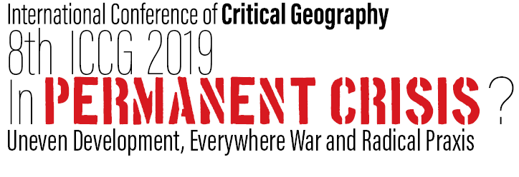
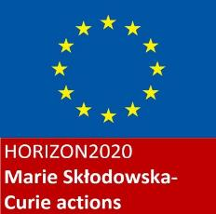
Researching HIV-positive gay migration through an intersectional lens: Theoretical, methodological and political implications
Cesare Di Feliciantonio (University of Leicester)
difeliciantoniocesare@gmail.com

Slide 2
Research background
Most research on HIV frames migration as a ‘risk factor’ across different contexts and communities
Main focus on prevention and pre-exposure migration, less attention devoted to people living with HIV
Living with HIV: improved health condition + stigma + (in)visibility
Intersection of homophobia + HIV-phobia (+ legal norms around migration, sex, drugs use, etc)

Slide 3
Research background (2)
2014 and 2016: research in Barcelona and Rome (24 interviews)
2018- : comparative research in England (Leicester and Manchester) and Italy (Bologna and Milan) [40 interviews so far]
‘unconventional trajectories’ of gay migration: from big cities to other big cities (challenging the small town- big city trajectory)
England, Italy and Spain: free access to ARTs (including undocumented migrants)

Slide 4
HIV+ and migration
Early work published after the diffusion of HIV-AIDS emphasized two main trajectories : i) the return to their hometown; and ii) migration towards major metropolitan areas where more specialist services were available
Most studies on HIV-positive gay migration rely on quantitative methodologies and adopt an epidemiologic/public health perspective + most studies focused on US and Canada
M. Brown (1995: 162): quantitative studies usually analyse and map the geographies of the virus rather than people living with it
Geographers have called for more qualitative research to explore the complexity of factors shaping HIV-positive gay migration

Slide 5
The (sexualized) imagery of the big city
NN (Naples-Rome): “moving to a new city is really exciting, new places to discover, new people to meet, you can re-imagine your social life”. When asked if he thinks Rome offers a better sexual life than Naples, his answer was: “I don’t think it’s the city, I think it’s just me now able to enjoy more and feel more sexually relaxed. (...) Moving has certainly helped me to explore more my sexual fantasies”
VF (Rome-Barcelona): “In Rome there is a lot going on, (...), I had a very active sexual life but in the last period I was living there I was becoming a bit paranoid, sex was not that fun anymore, I was travelling as much as I could to have fun so I realized it was maybe time to leave the city and moving to a place offering me the possibility to have that fun daily. (...) Barcelona is a new phase in my life, sure the city is very sexual, very sexual [emphasis] and so amazing for poz guys, but I think it’s my mind that has changed, moving was the right decision”

Slide 6
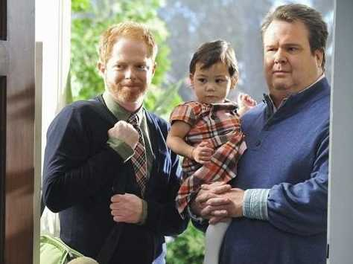
An intersectional perspective on homonormativity…

Slide 7
Geographical criticisms to the uncritical use of the concept of homonormativity as all-encompassing and uniform everywhere (e.g. Brown, 2009, 2012; Browne and Bakshi, 2013; Oswin, 2004)
Debate on homonormativity has not considered HIV as a category of exclusion: “homonormativity—like heteronormativity—is an exclusionary process; inclusion is for select bodies—white, middle-class, consumerist, Western, and often gay male bodies who have access to the consumer ‘freedoms’ of the West and who have more to gain from respectable performances of gay masculinity” (2009: 467)
What about HIV-positive people? Are they included or excluded from homonormative ′respectability′?
need to include HIV/health (but also age, faith, etc) in geographies of sexualities, beyond the “holy trinity” (Brown, 2012) of gender, race and class

Slide 8
…and the importance of the lifecourse
“recognition that, rather than following fixed and predictable life stages, we live dynamic and varied lifecourses which have, themselves, different situated meanings” (Hopkins and Pain, 2007: 290)
Need to explore the relation between places, identity and the lifecourse through an intersectional perspective
How does HIV reshape life choices and sense of the self? How does sexual life evolve over time and body changes? How do medical innovations (e.g. new drugs) affect everyday life, self-perception and life aspirations? Which possibilities are opened by relocating at different stages of the life course?

Slide 9
Emerging issues
Methodology: breaking distance, rethinking intimacy in the research process
Framing the experience of living with HIV through a life course perspective
Intersectional lenses: the importance of age, body shape, class/spending capacity, race (but also structural factors such as legal norms)
The role of the welfare system
What happens to those who are still detectable?

Slide 10
Methodological concerns
reject either paternalistic/moral position or pathologizing perspectives (when assuming for instance the death drive)
most research on HIV+ (and ‘deviant behaviours’) tends to rely on ‘distance’ and othering (for exception see K. Race)
Open and critical approach to positioning myself (HIV-status, sexual desire, background, experiences, migratory path, etc): acknowledging how our sexual and personal life evolves through the research process
Recruitment through ‘dirty participation’: “not ‘clean’ those elements that could compromise the analysis according to the positivist model of knowledge” (Di Feliciantonio and Gadelha, 2016: 280). The recorded interview is only the last step of a wider process that involves first being in the field (both physical and online spaces)

Slide 11
Framing the experience of living with HIV through a life course perspective
“HIV has always been there”: the direct association between HIV and homosexuality made the encounter with the virus “not a big surprise” (STAR, over 60, Milan, personal interview)
Immediate emotional shock (sense of failure, fear of death and rejection) vs acquisition of self-awareness and self-esteem
“I know this might sound harsh, but I always say ‘HIV is probably the best thing ever occurred to me’, I was living a shitty life, I had no friends, no real goals for myself, (...), it helped me to understand what I want, my priorities, (...), I finally see my place in the world” (STAR, p.i.)
Learning how “there are many things that are much worse” (MIMAN, 35-45, Milan, p.i., discussing his experience with HEPC)

Slide 12
Framing the experience of living with HIV through a life course perspective (2)
Change in sexual life: sex before the encounter with the virus as “always fearful, you cum and you think ‘Did I get it?’” (IAS, 45-55, Manchester, p.i.) vs after: “I finally started enjoying sex, I can relax, (...), I don’t need to fear fluids anymore” (BEN, 35-45, Manchester, p.i.)
Being undetectable as part of a new sexual identity (+ bareback)
Interviews in line with discourse of PrEP users about empowerment and loss of fear (role of pharmacopower over sexual life)
Development of narratives and strategies to avoid judgment and condemnation from sexual health practitioners about other STIs (e.g. attending different clinics)

Slide 13
Intersectional lenses…
Experiences of living with HIV, migration and ageing are not homogeneous but result from different (fluid) positions (e.g. body shape, class, race, faith, social networks, comorbidities)
E.g. What happens if you become HIV-positive after 50?
“People were shocked, ‘do you still have an active sexual life?’, ‘HIV-positive at your age?’, I got the most terrible questions, especially because I’m a medical doctor, so people expect me to be the responsible guy who does not take any risk. (...) I say fuck you to all of this, my life has never been better, I am healthy and I cannot transmit the virus so I am no threat to anyone” (MC, over 60, Milan, p.i.)
Avoid alarmist and uniform analyses of ageing with HIV (see NGOs reports)

Slide 14
The role of the welfare system
Free access to ARTs as central element in the destination choice (e.g. Barcelona rather than Berlin)
slow transition (6-12 months) to care in the new city (i.e. they continue to attend clinics in the city they were previously living in)
entanglement characterizing the political economy of gay lives in big cities: precarious work in the service sector combined with occupational segregation; the desire and sense of freedom of living in a new city; free access to ARTs, keeping HIV-positive gay men healthy and able to work.

Slide 15
What happens to those who are still detectable?
Being detectable becomes a new source of exclusion, rejection and fear (blamed for being ‘irresponsible’ and ‘risky’)
Not everybody can be undetectable (but institutional discourse and medical practice remove this issue- especially in the UK: therapies start right after the diagnosis, even before the results of resistance test)
“I was speaking to the group sharing my concerns about the viral load being detectable and XXX was surprised, asking me ‘How is that possible? Did you miss your drugs? Maybe it’s because of other STIs? (...) Discussing I realized that his doctor never mentioned him the possibility of therapies not working and he thinks of himself as being undetectable always and forever, (...), undetectability is the norm, if something goes wrong it must be because of you, ‘new therapies don’t fail!’ I’m being told” [research diary, September 2018]

Slide 16
Thank you for the attention ☺ Feedbacks and questions welcome… difeliciantoniocesare@gmail.com

