Slide 1
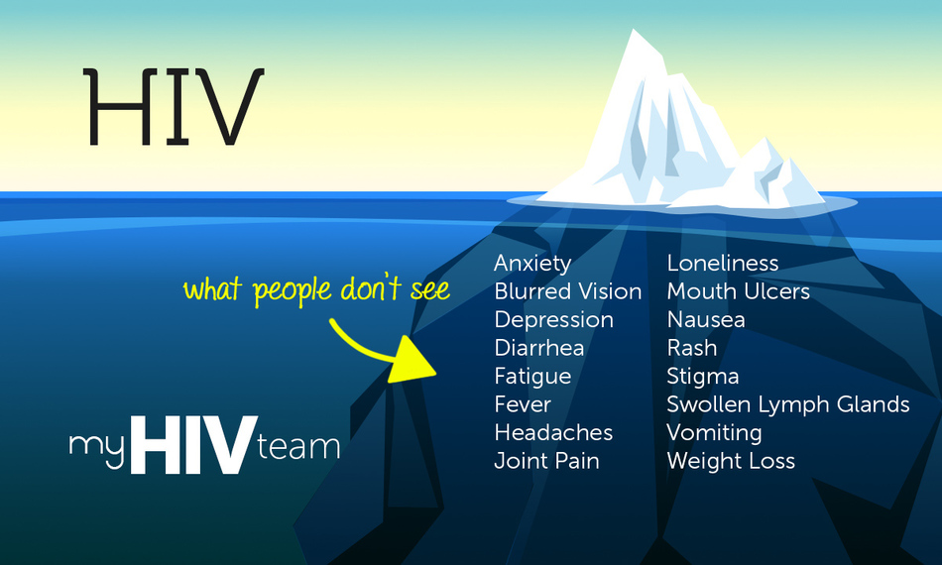
Learning to be alone.
The everyday construction of loneliness among ageing gay men living with HIV in England and Italy
Cesare Di Feliciantonio
University of Leicester
RGS-IBG 2019 session: The geographies of loneliness and solitude

Slide 2
Background
Increased number of PLHIV aged over 50 (20% globally, 35% in the UK, 45% in Italy)
Not homogeneous group (age; time of infection: ‘survivors’ vs newly diagnosed)
Increasing number of studies on the topic, mostly based on a medical/psychological and public health perspective: living with HIV is framed mostly as a medical condition, main effort being the measurement of the health-related quality of life (little focus on the cultural, economic and social impact of living with the virus)

Slide 3
Background(2)
Unanimous findings on higher risk of mental health issues- especially anxiety, depression and loneliness- for PLHIV50+
Rosenfeld et al (2014): ageing with HIV is ‘uncharted territory’ for medical practitioners, service providers and patients provoking uncertainty
THT(2017): main issues faced by PLHIV50+ in UK are poverty, inadequate social care, social isolation, loneliness and self-stigma
In the survey, loneliness is measured through the UCLA Three Item Loneliness Scale

Slide 4
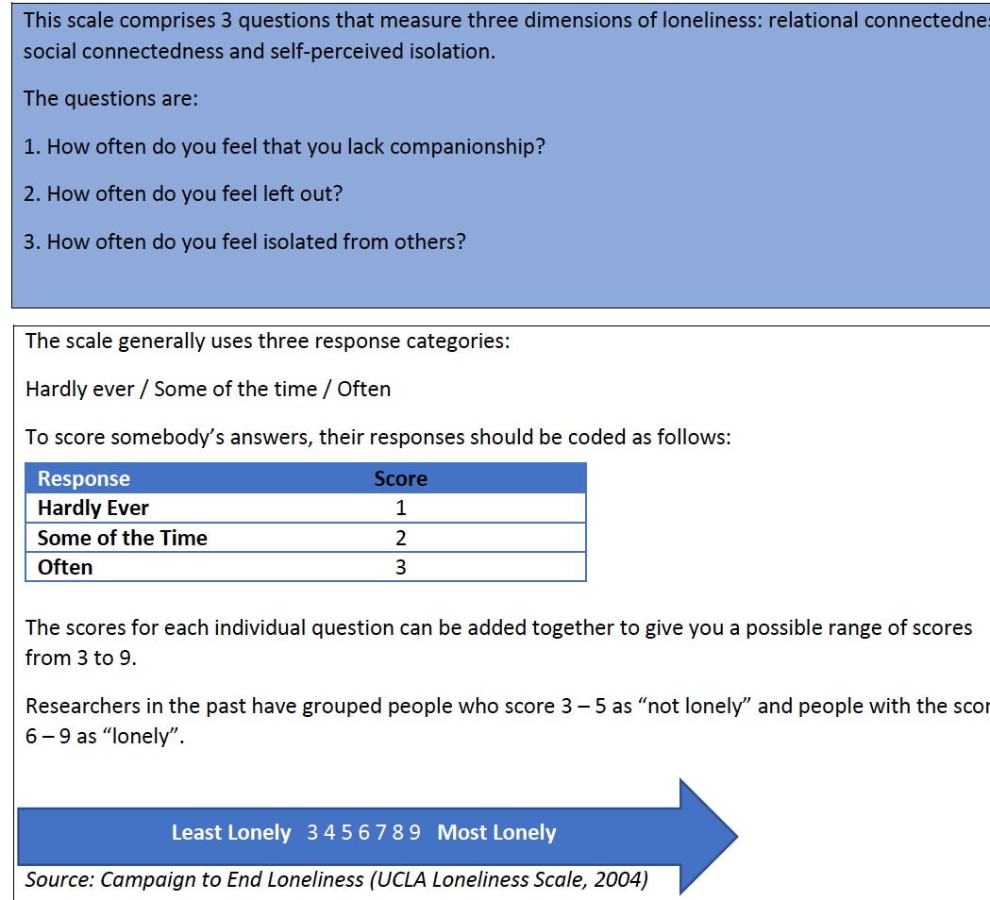
The UCLA Three Item Loneliness Scale

Slide 5
Questions and aim
Is this an adequate measure of loneliness for a population who has experienced strong social discrimination (in multiple forms) and has been dramatically changed by both medical innovations (less side effects and lack of ‘body visibility’) and cuts to welfare benefits?
Can we analyse loneliness without accounting for the multiple processes shaping people’s position into society?
Main aim: complicate the narrative on ‘loneliness’ (and ‘healthy’, ‘successful’ ageing) for PLHIV50+ by taking into account several factors who shape the experience of loneliness

Slide 6
The research
Multi-method project funded by the EC about the life trajectories of gay/bi/queer/MSM men living with HIV in England and Italy
48 completed biographic interviews so far (Bologna and Milan in Italy; Leicester and Manchester in England), 14 of them with men aged over 50 (7 in Italy, 7 in England)
Interviews in two stages (stage 1: the participant is asked a general question about his life, I do not intervene or ask questions; stage 2: questions based on what emerged or missing during stage 1)

Slide 7
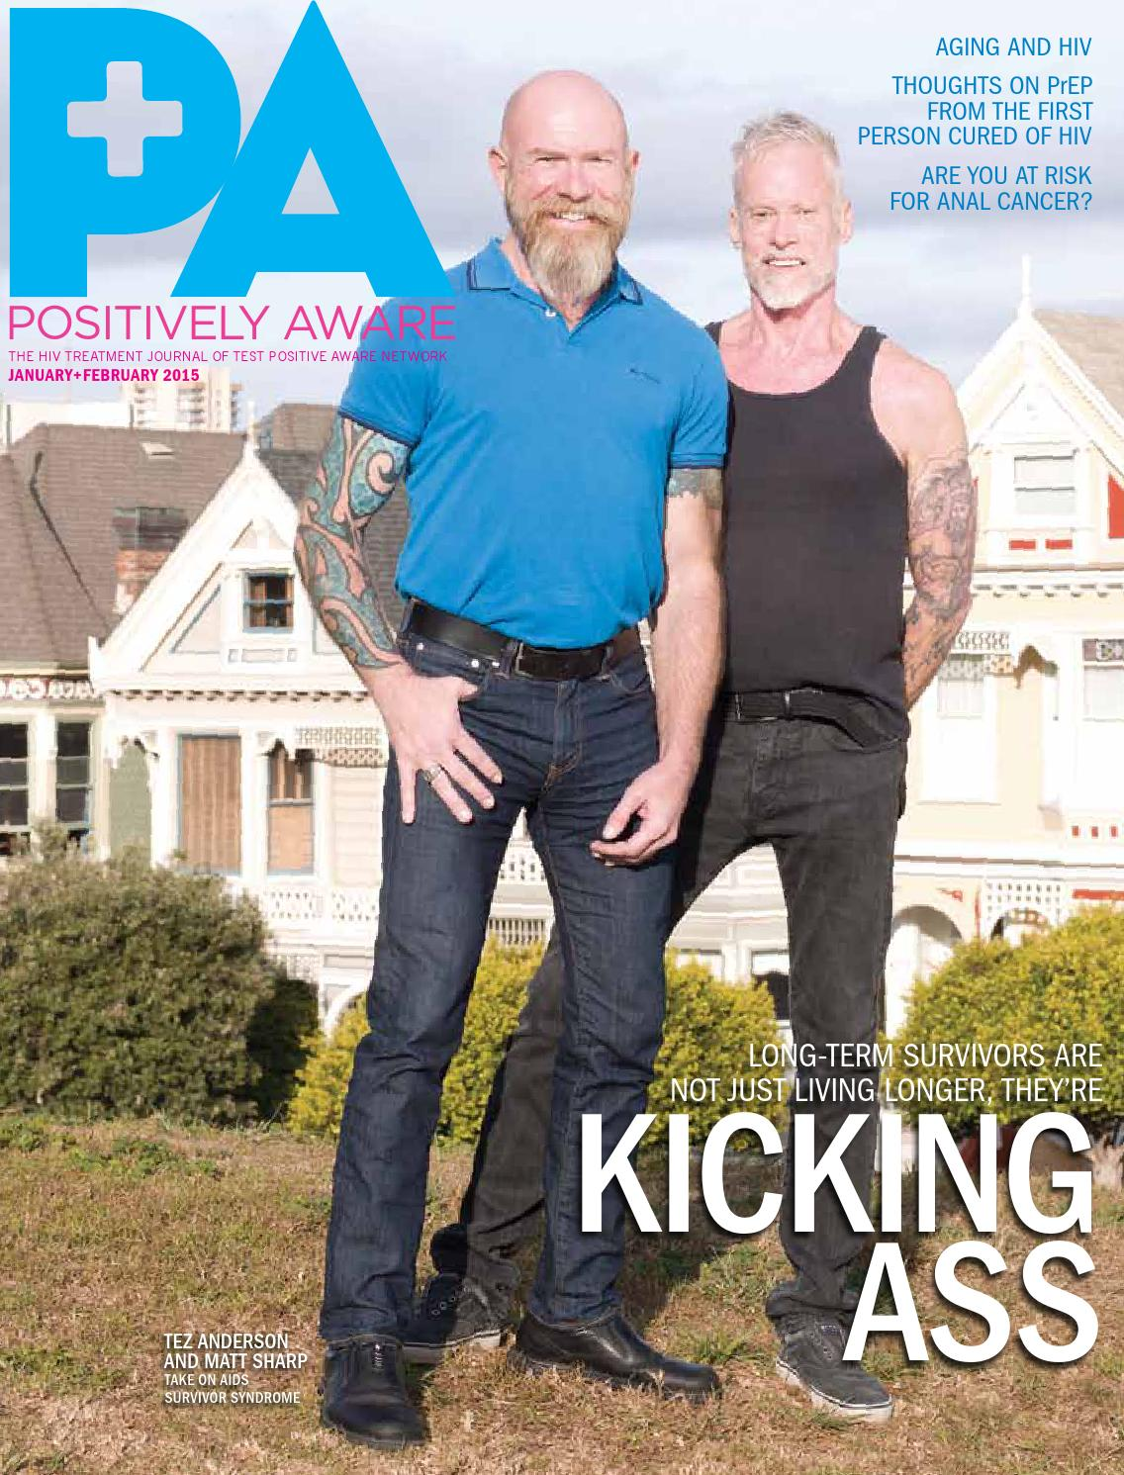
The temporality of loneliness (and the benefits of qualitative deep methods)
Most studies on loneliness focused on the ‘survivor syndrome’, i.e. the struggle to cope with the loss of community members, friends and lovers

Slide 8
PORTLAND (Manchester, aged over 60, living with HIV since the end of the 1980s):
“You struggle to cope with this, living in a small city [he was talking about living in Brighton in the 1990s] every month you realize someone else died, somebody asks ‘have you seen...?’, we often did not know what really happened, you could only guess he was dead (...) I still find asking myself ‘why me’? ‘why did I survive’?” [1st interview]
P: I am a alcoholic, I am aware of that.
C: Could you elaborate on this, describe your habit maybe?
P: (...) I’m bored, I’m lonely, I don’t know what to do after 2pm so I drink (...) there is nothing I really feel attached to, I know I’m depressed [2nd interview; emphasis added]

Slide 9
Portland’s list of activities and contacts
he volunteers for a NGO at least once a week + he is part of a special mentoring program for PLHIV, i.e. he has 1-to-1 meetings out with people struggling to cope with their diagnosis or other issues
although retired, he still works at least 1 day a week for one of the former companies he worked for in the past (“it is just a hobby”)
he still has a very active sexual life (he said he has a range of between 4 and 10 partners a month, including group sex meetings lasting few days)
he has a couple of old friends he meets on a monthly basis
he has a former lover which he consider a dear friend living in Spain which he usually visits once per year (+ he usually goes on another holiday trip per year)

Slide 10
P: I can see I’m not really alone and I have things and people I connect with, maybe I just miss a life partner
C: Would you like to have a long-term relationship?
P: Not really, it did not work for me [2nd interview]
Portland’s example shows clearly the ambiguities of asking people to self-evaluate and describe feelings: he first described his feelings of loneliness and solitude as clear and unambiguous, then when asked to elaborate more in detail about his connections, he acknowledged there are people and activities he feels connected to and he engages with

Slide 11
STAR, aged over 60, not working but not retired yet, always lived in Milan, living with HIV since early 1990s, very rough medical history (a doctor referring to him as a ‘therapeutic failure’)
“I have never really had friends (...) my life has been all around work and family [he lived with his parents up to his late 30s] (...) I went out only to find casual sexual encounters, there were no many words, no exchange of phone numbers, my life has always been my parents and I”
mid-2000s: “I saw this leaflet in the hospital reception hall, it was about weekly meetings for people living with HIV, I took it (...) I probably thought about it for weeks or even a month before going. It was the best decision of my life, everything has changed since then (...) I started having friends after my 50s, I finally felt engaged and belonging”

Slide 12
2013-14: life-changing decision, stop working despite not being eligible for pension yet
“I love it, I don’t want have anyone telling me what to do, I love being by myself, you know I have to come back to Milan around every two months for the medical check-ups and collect my drugs, so I stay a couple of weeks or a month to do the volunteering work, see some friends but then I can’t wait to leave again (...) I have finally discovered my life and I really enjoy it”
Central role of STAR’s class status: he comes from a middle class family of homeowners, he had a good ‘traditional’ job (with ‘fordist' benefits) in the same company all his adult life. He has been able to decide to leave his job despite not qualifying for pensions or other benefits and still being able travel most of the year.

Slide 13
Benefits generating loneliness?
UK 2013-5: abolition of Disability Living Allowance (DLA- 10%PLHIV received it) and introduction of Personal Independence Payment (PIP)
NAT (2017): PLHIV are less likely to be awarded PIP following reassessment, less likely to receive an increase in their rate of benefit when shifting to PIP, more likely to receive a decrease in their rate of benefit when shifting to PIP

Slide 14
GEORGE: Leicester, aged over 50, diagnosed very late, he was hospitalized with a AIDS diagnosis, leaving him out of work for years, had severe mental health issues, now getting better, some forms of volunteer work and hei s learning how to redevelop social relations (strong feeling of loneliness, lack of family and friends around)
“I’m really trying to get back on my feet and I think I’m doing good, but it is hard (...) I’m so worried about my benefits, you never know (...) they ask me time by time to send new documents and go through new medical examinations (...) and they send you these letters to show up the next week (...) ‘what if I do not get the letter or I am not home?’ (...) sometimes I’m worried that because I’m feeling better I will lose benefits (...) few months ago one of these doctors said ‘You really look better!’ and I don’t know, I was petrified (...) what if they revoke my benefits because they say I’m fit to work? (...) I’m better but not ready for full time work or taking responsibilities, I need my time and this really stresses me out”

Slide 15
The everyday experience of loneliness as shaped by several factors:
CLASS (vs reliance on benefits)
COMORBIDITIES and their impact on work and everyday life
AGEISM in the gay community
CHANGES in forms of activism and participation
STIGMA ( both enacted and felt) for those who are still working
Need to engage with qualitative methods allowing to explore in-depth people’s lives and go beyond simplistic measurements of loneliness that do not take into account structural factors, inequalities and different life trajectories

Slide 16
Thanks for your attention! Questions and feedback welcome ☺ difeliciantoniocesare@gmail.com

