Slide 1
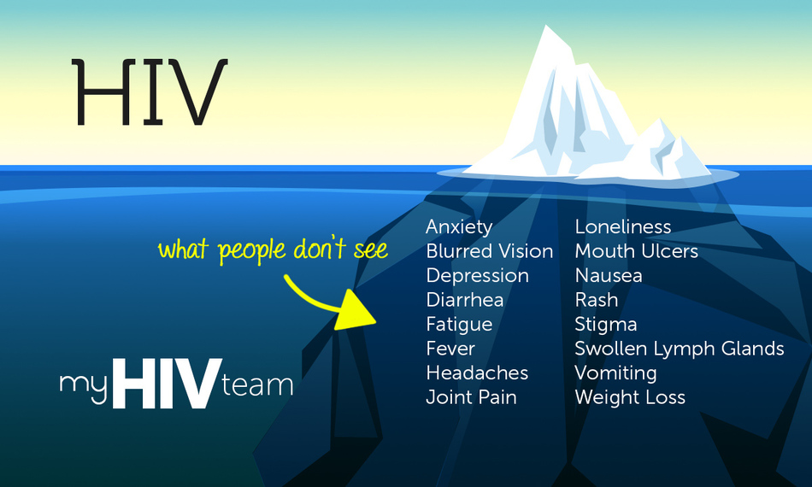
The emotional geographies of HIV-positive gay migrants in England and Italy
Cesare Di Feliciantonio
University of Leicester & Manchester Metropolitan University
V European Geographies of Sexualities Conference Prague

Slide 2
The research
Multi-method project funded by the EC about the life trajectories of gay/bi/queer/MSM men living with HIV in England and Italy
51 completed biographic interviews so far (Bologna and Milan in Italy; Leicester, London and Manchester in England)
Focus: 28 interviews (Italy and Italian migrants in England)
Interviews in two stages (stage 1: the participant is asked a general question about his life, I do not intervene or ask questions; stage 2: questions based on what emerged or missing during stage 1)

Slide 3
Boccagni and Baldassar (2015): the migration process offers a poignant window from which to view emotions, in the light of their everchanging cultural bases, transforming emotional life through hybrid cultures of emotion or emotional trajectories brought about by emotions on the move and out of place.
Pain (2001): migration is not a linear movement of ‘leaving behind’ a problematic home for the exile: home is a site of attachment which engages us in complex multidimensional relations, encompassing multiple returns to the past and renegotiations in the future.

Slide 4
“Love, whether it is for a partner, lover or friend, or for a child, parents or other kin, is so often a key factor in the desire and the decision to move to a place where one’s feelings, ambitions and expectations – emotional, sexual, political, economic, hedonistic etc. – can be lived more fully and freely. (...) Like love, and sometimes alongside it, sex can play a decisive role in the imagination and enactment of the choice to migrate. The fact that some of these relationships change and sour later on, or that one or both of the people had, or develop, exploitative plans, does not diminish the original feeling in the imagination, motivation and realisation of migration.” (Mai and King, 2009: 296)

Slide 5
Ambivalent emotions (1): Italy
Predominant narrative of Italy as ‘backwards’ [arretrata] when referring to sexuality and HIV
GEGE (30-40, Milan- London, 1st interview): “You cannot really talk about HIV in Italy, (...), everyone pretends to be negative, but then they get gangbanged in a darkroom, (...), I can’t stand anymore that hypocrisy, I want to be free to talk about sex”
COSTA (20-30, Latin America- Milan, 2nd interview): “Every time I come back from Berlin, Barcelona or Paris I wonder what am I doing here, there is like a 10 years-gap between there and here, (...), when I’m there I feel so comfortable in just being me”

Slide 6
Ambivalent emotions (2): Italy and Milan
COSTA (1st interview): “Milan is nice, (...), I really like my life here, I have my job, my friends, I live in a nice place, (...), every time I go back to [name of his home country] I feel I don’t belong there, it really irritates me, sometimes I wonder how I was able to live there for so long”
GEGE (2nd interview): “Sometimes I cry when I think about Italy, my friends there, I had a very good life between my 20s and 27s, (...), London is home, (...), I think it is the perfect place for a single gay man in his 30s, I really love it, (...), I have always dreamt of living in London or Amsterdam, (...), this city freaks me out sometimes, English guys are weirdddd [straniii emphasis in original], (...), I don’t have any English friend, I can’t really stand English people”

Slide 7
Ambivalent emotions (3): healthcare
THOMAS (20-30, North Africa- Milan, 2nd interview): “Some doctors are really judgemental, it is difficult sometimes, especially every time I get a STI, (...), you can see the look in their faces, (...), I prefer not to say to doctors what I do, I want to avoid to be preached [voglio evitare la morale]”
“It is really good to have a free system, you don’t have to worry about not having the money to buy the meds, (...), it is really really comforting, (...), healthcare here in Milan works very well, there is nothing really bad I could say”
MORO88 (30-40, Milan- Manchester): “The NHS scares me a bit, doctors don’t want to prescribe you anything, every time I have to pretend to feel much worse, (...), Italian doctors are so much better, (...), sometimes I had the impression [when he was living in Italy] they [doctors] were uncomfortable in talking about sex, so I stopped saying anything, here [in England] I feel much more free to say what I do and what I like”

Slide 8
Ambivalent emotions(4): migration
Widespread representation of the overall migration process as connected to loneliness, although most participants frame this as an opportunity to grow and ‘learn about yourself’
Consistent use of a symbolic comparison between migration, coming out as gay, and learning to live with HIV, no homemaking practices associated to the gayborhood
SEBI (30-40, Sicily- Milan): “It is not easy but you learn to live with it [the virus], (...), it took me a long time to get where I am now, (...), the loneliness of my teen years, the struggle with the coming out, moving to Milan, HIV, every time you learn something new about yourself, every time you learn better how to be alone, (...), there is no one but you at the end of the game”

Slide 9
Ambivalent emotions(5): the pills
Frequent showing of the pills during interviews
Sense of pride in exhibiting them, pills usually kept in the kitchen because “it is part of my breakfast, (...), it seems natural to me to keep it here [the kitchen], it gives me comfort” (GIANNI, 35-45, Bologna- London)
LOVER (35- 45, Sicily- Milan): “When I see it [the pills’ bottle] I feel defeated, it is the only moment when I think ‘shit the virus is stronger than me’, (...), every morning I get remembered that I have to take care of myself to stay healthy, it is not me controlling the match”

Slide 10
Ambivalent emotions (6): the interview
“I am a friend of THOMAS, I would be interested in being interviewed, (...), THOMAS told me it was very useful for him, I would like to help you” (message received from TARIQ)
“ I am not sure I want to do the second part [of the interview], is it a problem? This is a bit too much for me” (THOMAS at the end of 1st interview)
“Thanks Cesare, yesterday was really important” (THOMAS, text sent the day after 1st interview)
“I am so happy to do this, it has helped me to figure out few things” (THOMAS, response to my invitation for a second interview)

Slide 11
Emotions and place as co-constitutive and moment-based
The relationship between place and emotions framed in relation to another place (and the emotions associated to it)
Impossibility to reduce the experience of migration and HIV to unambiguous emotions
Acknowledging the constitutive and generative function of the biographic interview

Slide 12
Thanks for your attention! Questions and feedback welcome ☺ difeliciantoniocesare@gmail.com

