Slide 1
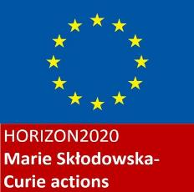
A geographical relational analysis of chemsex through the self-narratives of Italian gay men living with HIV
Cesare Di Feliciantonio
(Manchester Metropolitan University & University of Leicester)
difeliciantoniocesare@gmail.com

Slide 2
Research background
Use of biographic narrative interpretive method (BNIM; Wengraf, 2001), the focus is on people’s lives, chemsex emerged from people’s narratives
Presentation’s focus: 36 interviews with Italian research participants based in the different cities who spoke about chemsex
Main aim: unpack the complex negotiations between sexual practices, place, spatial imagery, mobility/tourism, bodies, the performance of masculinities and drugs consumption

Slide 3
Main argument
Place occupies a central role in the research participants self-narratives around chemsex. It is constructed relationally, through movement and encounter with other places. In these narratives, Italy is represented as sexually backward.
3 main (interconnected) dimensions of place:
Physical (e.g. home, the sauna, the club, the ‘gayborhood’)
Imaginary (e.g. specific cities abroad exercise a strong ‘sexual power’)
Digital (e.g. hook-up apps)

Slide 4
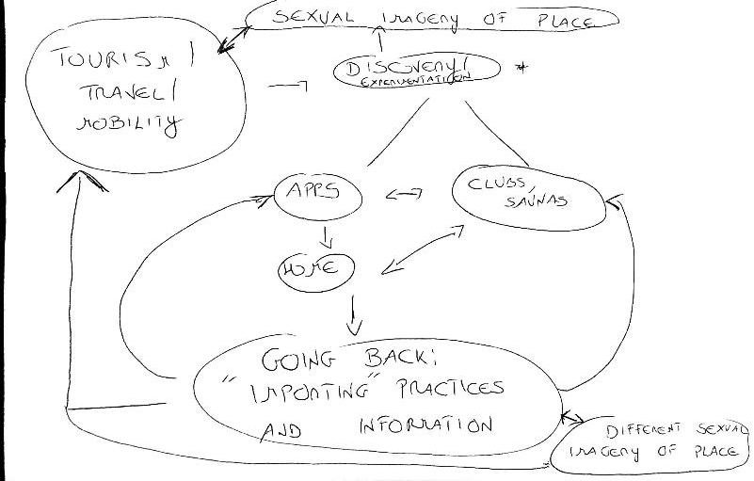
Mental map created to analyze the narratives around mobility, place and sexual experimentation (discussed with 5 participants)

Slide 5
Relational geographies of chemsex (1): mobility and tourism
Specific cities (e.g. Amsterdam, Barcelona, Berlin, Brussels) play a central role for sexual experimentation
RC: (...) I hooked up with this guy in Amsterdam [he was on holidays there], we smoked and wow, it was just amazing, (...) I didn’t want it to end.
Q: What did you smoke?
RC: Crystal, it was my first time, crazy. This is how I discovered chemsex [English word used]
Q: Was it your first time using drugs to have sex?
RC: Not really, I had tried G sometimes but just for one-to-one intercourses lasting few hours. This lasted maybe 36 hours and at some point we were 6, (...), I had never experienced something like that.
Q: So you think in Italy chemsex was not very widespread...
RC: Not at that point [2011], I think people did it mostly when travelling abroad, (...), now it is much more widespread but it still different, almost no one does crystal, here it is all about crack [basata]

Slide 6
Relational geographies of sex (2): Italy as ‘backward’ (Rome, 2016)
GN: (...) Sometimes I feel like people here don’t know anything, it’s like they don’t watch porn, I don’t really understand, (....) apparently nobody does bareback [English word used], nobody uses drugs, everybody is HIV-negative. (...) Many times people stopped chatting with me because I said I was HIV-positive, (...) they say they don’t do drugs but then they are high and come with the story ‘This is my first time’, ‘Normally I don’t do these things’, (...) crap, this country is so backward [arretrato], any other place I travel to people are cool with naming things (...), I like having sex with drugs, it is fun, I am not ashamed of what I like.

Slide 7
Relational geographies of sex (3): everybody does chemsex but is HIV-negative (Milan, 2018)
“Today I counted 76 profiles referencing to bareback and/or chemsex on Grindr (3 hours spent in total; radius of 3km from my location), none of them stated ‘undetectable’ for HIV-status, 24 ‘negative on PreP’, 9 ‘negative’, 43 no status shown” (research diary, Milan, July 2018)
SEDI: (...) this is Milan, chemsex everywhere but everybody is negative.
Q: How do you feel about that? Do you usually disclose your status?
SEDI: Naaa, why should I? I don’t go to chemsex parties to chat, I want to smoke and have sex.
Q: What do you usually smoke?
SEDI: Basata like everyone else, people here usually use that or G.
Q: So in your experience people don’t smoke T at sex parties?
SEDI: I know why you are asking that, abroad T is very common, here not much. (...) Maybe at some point it will become popular here too, everything comes late in Italy, but I’m not sure, too expensive for the Italian standards I think. Personally I prefer basata because it creates a good vibe, in the past I saw some pretty ugly situations with T, it makes people really paranoid.

Slide 8
Relational geographies of sex(4): apps and home
Primary sites for experimentation and information
The private home chill-outs (a very common word to refer to home chemsex parties, usually open to strangers) as friendly places to meet new people
JD: “I like having lots of people around my place, I have made so many friends through Grindr. We go out, spend lot of time together, holidays, (...), you know I had a very hard time after the HIV diagnosis, now I definitely feel less alone, (...), I’m pretty lucky since I own my flat and have a decent salary so I can afford to invite people for partying here, there is always someone new, it’s fun, (...), my closest friends are allowed to stay even for days, when I’m at work, I don’t mind, most of them live with their parents or share flats so I help them”

Slide 9
Relational geographies of sex (5): apps and home
Tight connection between the digital space of the hook-up app and the private/public character of home (usually open and accessible to anyone connected)
Alienation/isolation vs sense of belonging
Social class (not everyone can host a house party) + sharing (wealthy participants usually share drugs they have but this can be a source of tension)
Challenge to hegemonic values of beauty and masculinity (e.g. NN: “you are living the moment, you are high, lost in pleasure, there is no age or beauty standard, (...), at some point you can really fuck whoever you want”

Slide 10
Some concluding thoughts..
Qualitative, in-depth methods allow complex analyses that go beyond pathologizing medical and mediatic discourse
A place-based, relational, geographical analysis offers the possibility to explore the complex negotiations between sexual practices, identity and desire
The narratives show how practices go beyond hegemonic models and discourses
Need to explore more in-depth how different recreational drugs shape sex and being with others

